Slide 1
WOORY Industrial
- HMG HV PTC HTR Line Up -

Slide 2
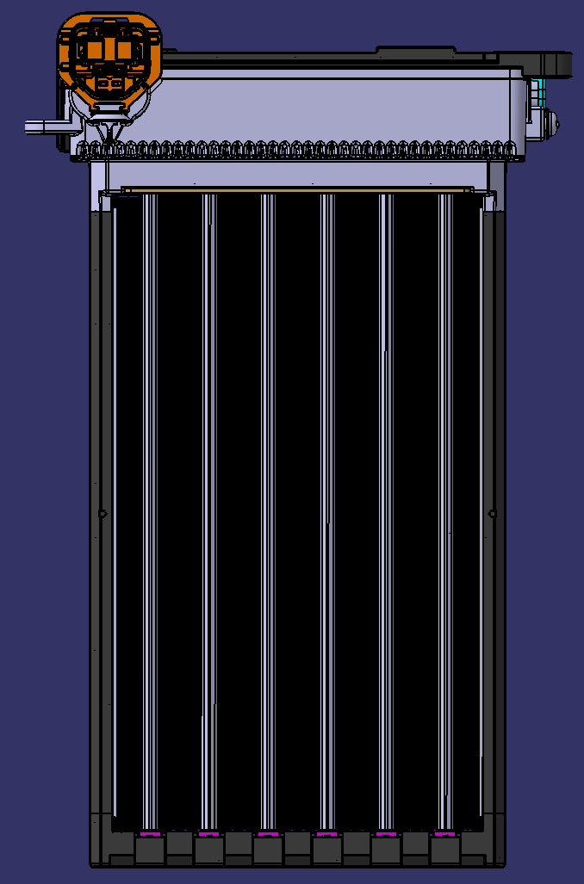
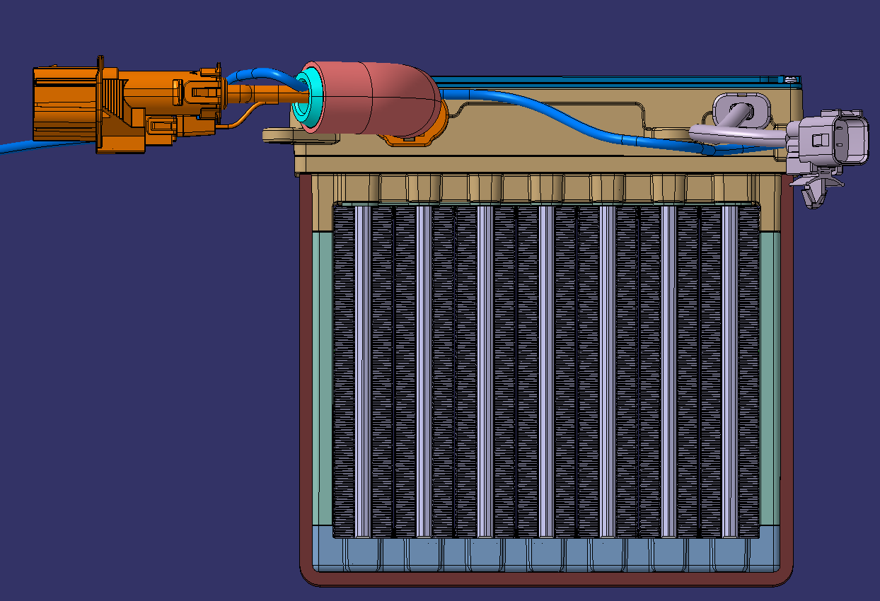
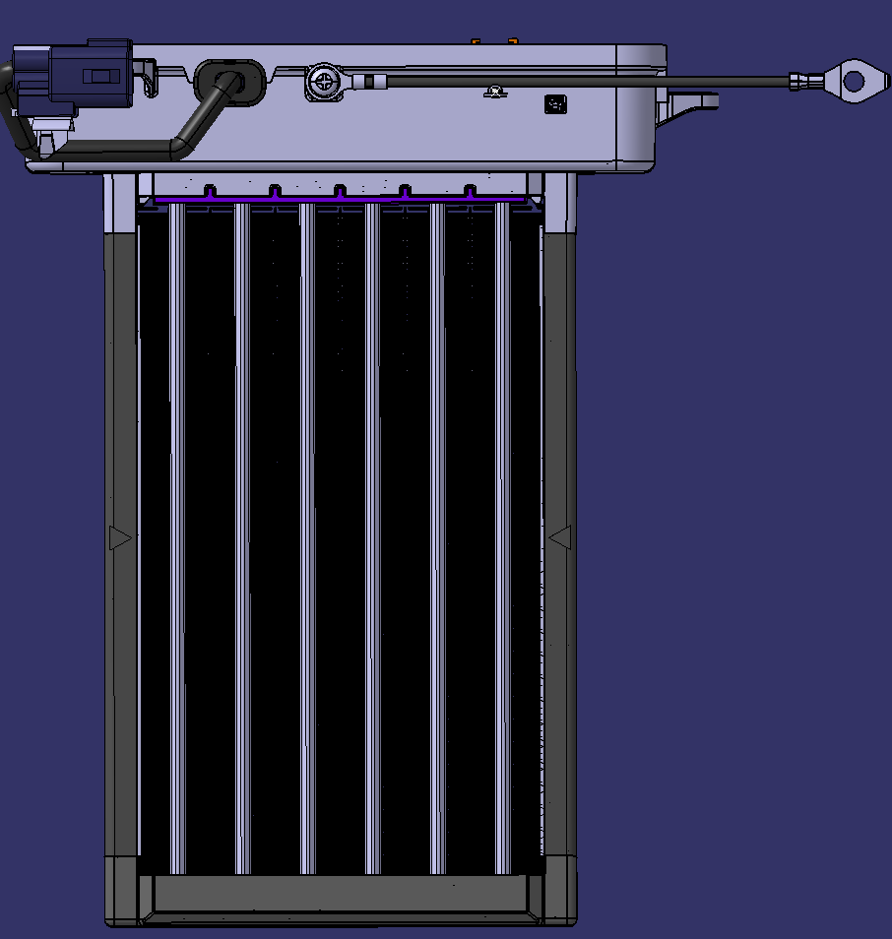
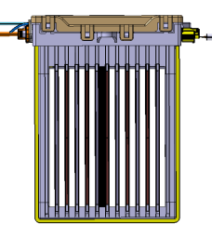
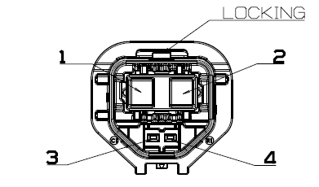
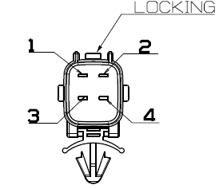
1. WOORY HV PTC HEATER Line up - HMGPTC HEATER
차종 |  | MVa / MEa / NEa / CVa | MVa / Mea (REAR) | SU2I / KY / AY | QV / SVm / BJ1 | OS EV | 비고
Production Site |  | WRA | WRA | WRI | WRS | WRK
제품 형상 |  |  |  |  |  |  | 1. HV CONNECTOR - 업체 : APTIVE - P/N : 35415839 2. SIGNAL CONNECTOR - 업체 : KET - P/N : MG651098-5
Size | Core Part | 269(L) x 158(W) x 32(T) | 185(L) x 155(W) x 32(T) | 240(L) x 150(W) x 30(T) | 269(L) x 134(W) x 34.5(T) | 230(L)x185(W)x30(T)
 | PWM Part | 80.7(L) x 180(W) x 42(T) | 38(L) x 199(W) x 76.5(T) | 81(L) x 208(W) x 40(T) | 78(L) x 175(W) x 40(T) | 204.2(L)x88.5(W)x40(H)
 | ZONE | 상/하 듀얼 | 좌/우 듀얼 | 상/하 듀얼 | 상/하 듀얼 | 좌/우 듀얼
Nominal Condition | Voltage (Vdc) | 654V (240~890V) | 654V (240~890V) | 325 V (220~440) | 358 V (220~440) | 360 V (220~440)
 | Nominal Temp.(℃) | 0℃ | 0℃ | 0℃ | 0℃ | 0℃
 | Air mass flow | 300kg/h | 300kg/h | 300kg/h | 300kg/h | 300kg/h
Performance | Power(Watt) | 6,300W | 4,000W | 4,000W | 5,500W | 5,500 ± 10%
 | Pressure drop(Pa) | Max 75Pa | Max 75Pa | Max 75Pa | Max 115Pa | MAX 80
 | Stable Current(A) | 9A | 6A | 12A | 15.4A | 15.3
 | Inrush Current (A) | - | - | - | - | Below Stable current x 130%
 | Weight | 2.3kg | 2.0kg | 1.9kg | 1.9kg | 2.3kg

